Slide 1
ICT8304 : System ANALYSIS & DESIGN
Lecture 04: Use Case Analysis
Venue: CIT Theatre
Time: 2-4pm

Slide 2
Lecture Outline
Use Case
Use Case Diagram and Description
Building Use Cases
Use Cases and Functional Requirements

Slide 3
Use Case
Use cases illustrates the activities that are performed by users of a system and how a system interacts with its environment
a means of expressing user requirements
Use cases are used extensively in the analysis phase.
The text-based use case is easy for the users to understand, and also flows easily into the creation of process models and the data model
Use cases are used to derive more detailed functional requirements for the new system.

Slide 4
Use Case
A use case depicts a set of activities that produce some output result.
Each use case describes how an external user triggers an event to which the system must respond.
Creation of use cases is often done as a part of interview session with users or a part of JAD sessions.

Slide 5
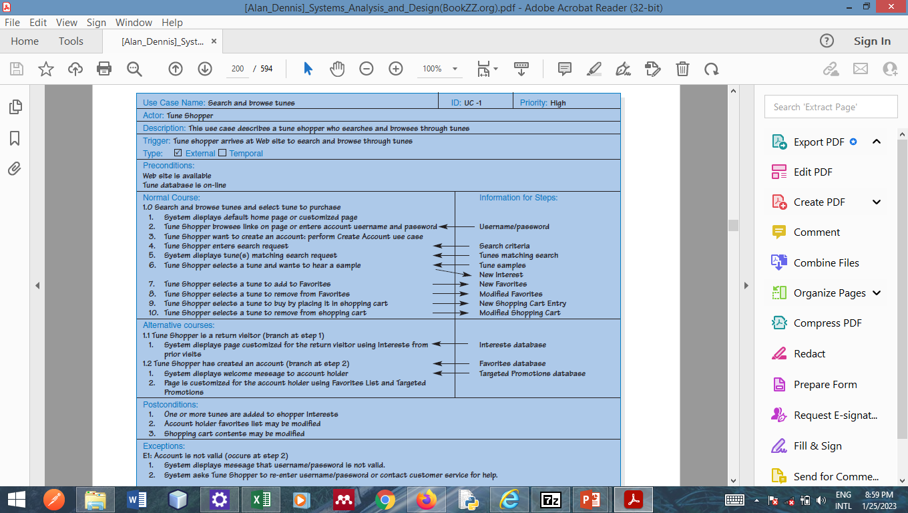
Sample Use Case
Tune Shopping System
Search Tune
Purchase Tune
Promote Tune
Tune Shopper

Slide 6
How Are Use-Cases Created?
Two steps:
Draw Use Case Diagram
Translate diagrams into descriptions
Notes:
May be done in reverse the steps

Slide 7
Use Case Diagram & Description
A use case diagram is a graphical representation which illustrates in a very simple way the main functions of the system and how the various end users interact with it.
Use case are mostly defined using the verb-noun naming convention. Examples: Make Payment, Issue Book, Get Grades.
Use case description is the text based, detailed, written account of the sequence of steps performed by an analyst to accomplish a complete user task
Each use case describes one and only one function or discrete task

Slide 8
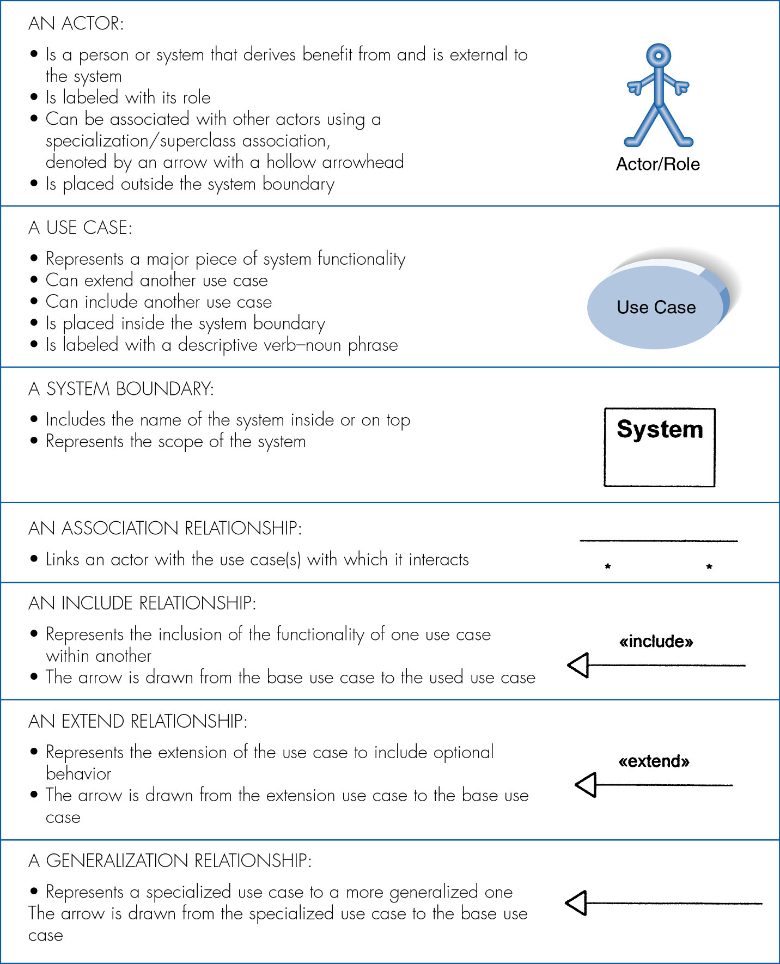
Syntax for Use-Case Diagram

Slide 9
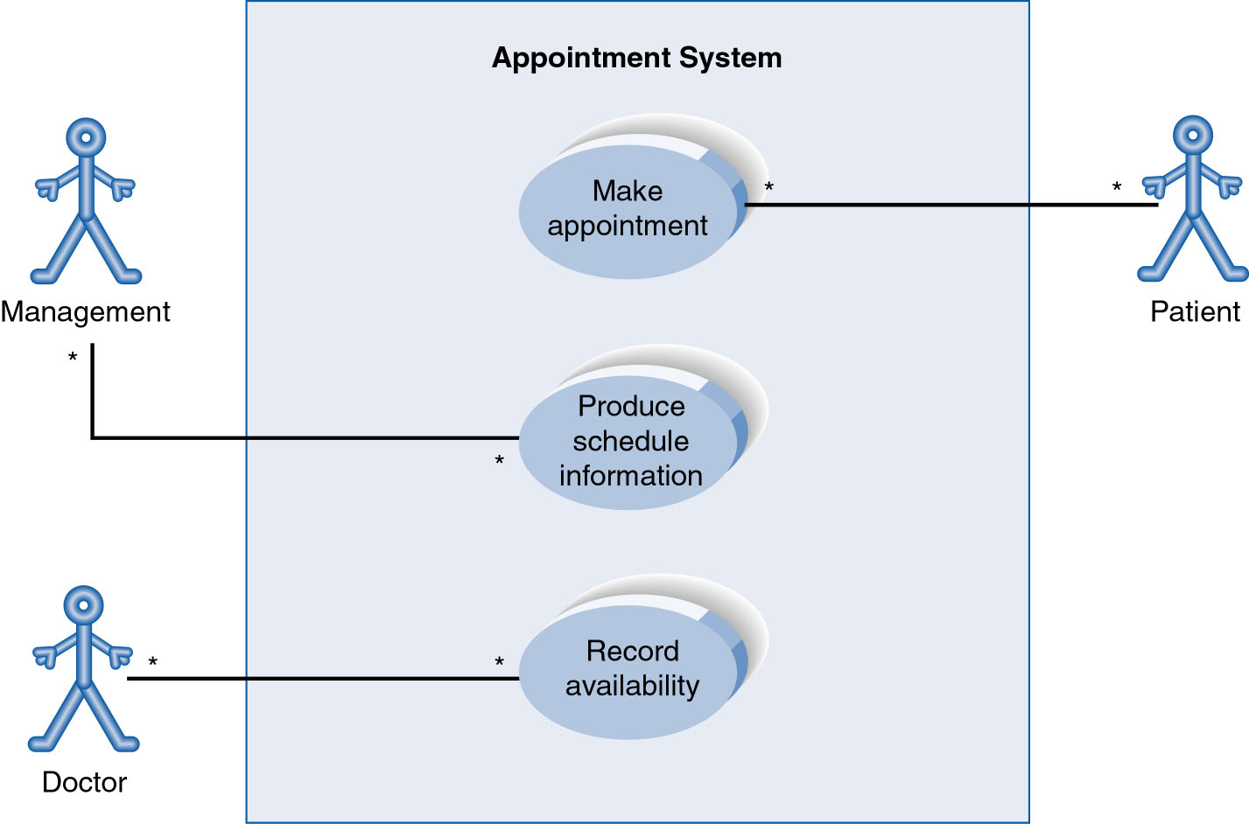
Use-Case Diagram for Appointment System

Slide 10
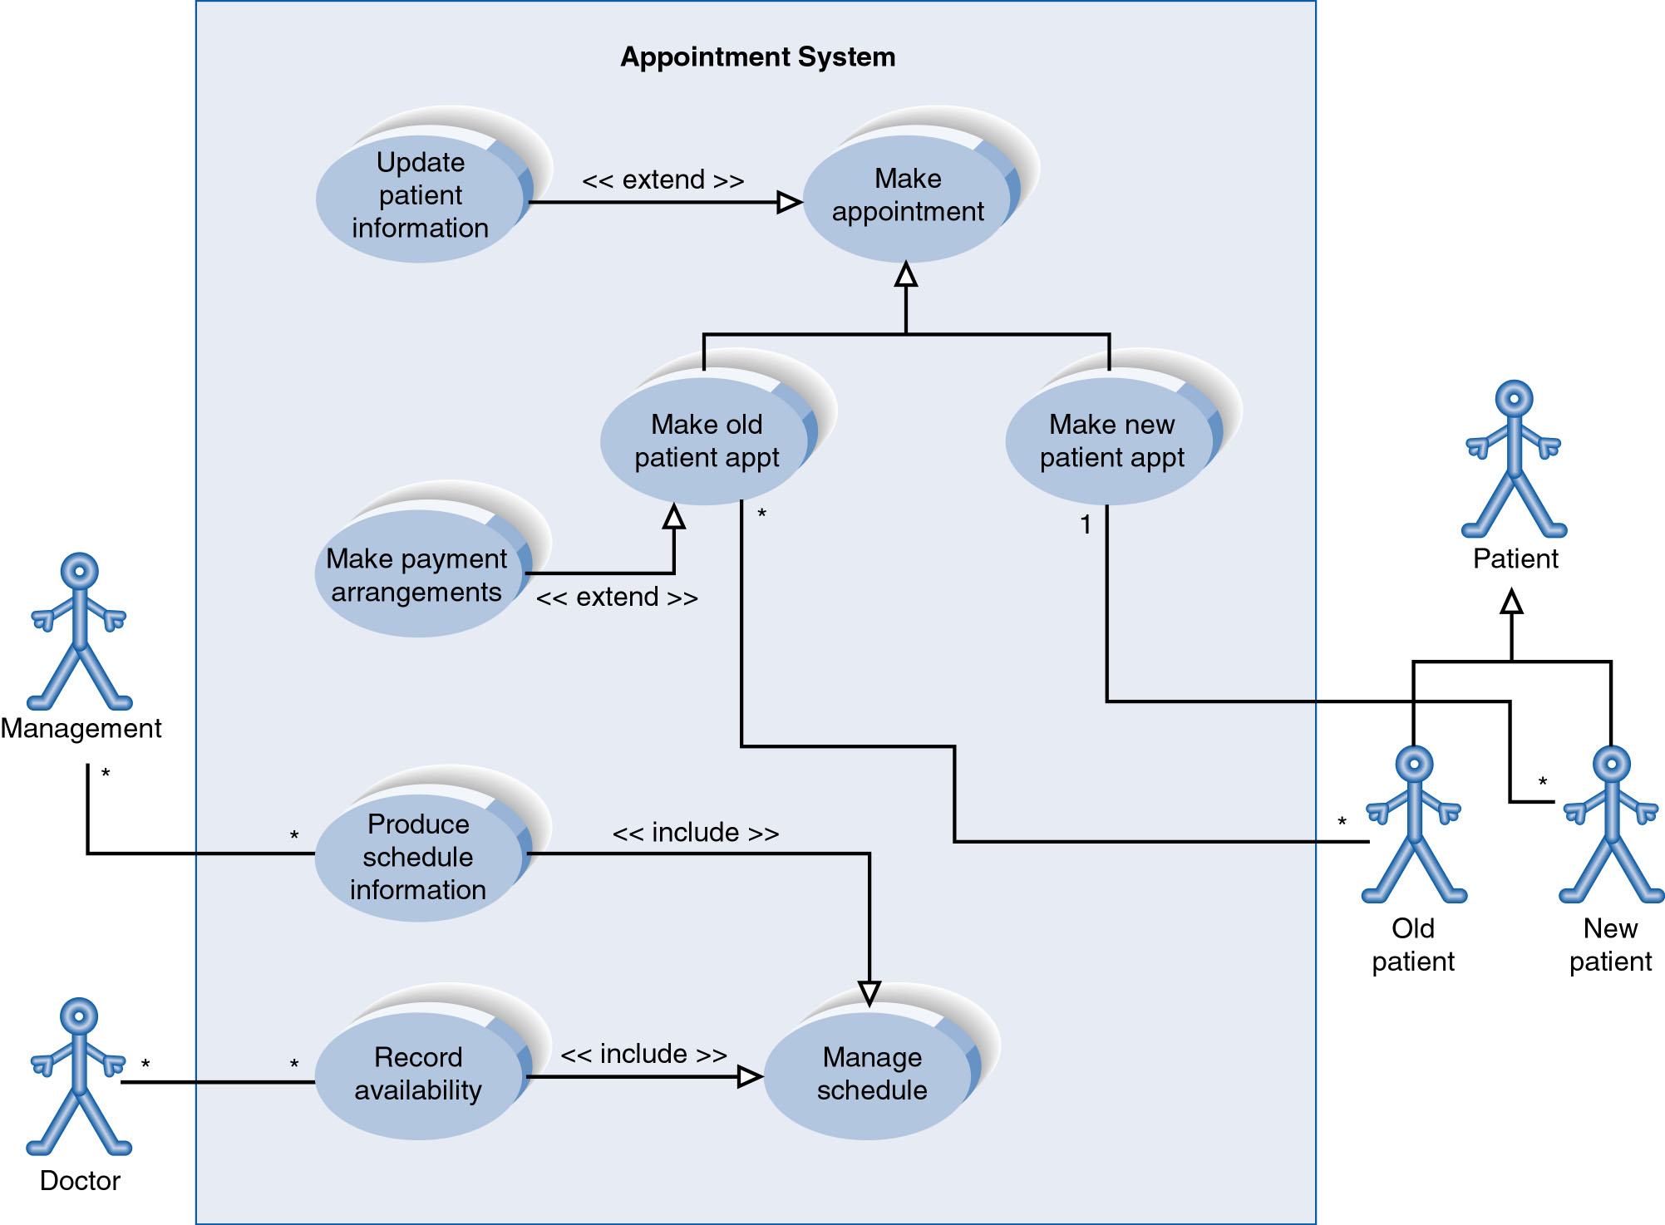
Extend and Include Relationships
Notes:
Optional Behaviour- Update patient info and Make payment arrangement Inclusion of functionality- Manage schedule

Slide 11
Syntax for Use-Case Description
Use Case Name: Priority :
Actor :
Description:
Trigger :
Preconditions :
Normal Course: | Information for Steps
Alternative course:
Post Conditions:
Exceptions: optional

Slide 12
Elements of a Use Case
1. Basic Information
Name: The name should be as simple, yet descriptive, as possible and defined using the verb-noun naming convention. Examples: Make Payment, Issue Book, Get Grades.
Description: The description briefly conveys the use case’s purpose.
Priority: The priority may be assigned to indicate the relative significance of the use case in the overall system
Actor: The actor refers a person, another software system, or a hardware device that interacts with the system to achieve a useful goal.
Trigger : The event that causes the use case to begin. A trigger can be an external trigger, such as a customer placing an order or temporal trigger, such as a DVD becoming overdue.

Slide 13
Elements of a Use Case
2. Preconditions
Use cases are often performed in a sequence in order to accomplish an overall business task.
These preconditions define the state the system must be in before the use case commences.
For example in order for a student to register courses in the BUK portal, s/he must be login

Slide 14
Elements of a Use Case
3. Normal Course
This lists the steps that are performed when everything flows smoothly in the system.
This is sometimes called the “happy path” because there are no problems or issues that arise when the steps are able to be followed normally.
As you read through the steps, you can clearly understand the interactions that occur between the user and the system.
The steps are listed in the order in which they are performed

Slide 15
Elements of a Use Case
4. Alternative Course
Alternative courses are included to depict branches in logic that also will lead to a successful conclusion of the use case.
The location where the branch in logic from the normal course occurred is clearly stated.

Slide 16
Elements of a Use Case
5. Post Condition
Define the final products of the use case
These post conditions also serve to define the preconditions for the next use case in the series.

Slide 17
Elements of a Use Case
6. Exception
In order to be complete, a use case should describe any error conditions or exceptions that may occur as the use case steps are performed.
These are not normal branches in decision logic, but are unusual occurrences or errors that could potentially be encountered and will lead to an unsuccessful result.

Slide 18
Creating Use Case Diagram and Description
They are four (4) steps
Identify the Major Use Cases
Identify the Major Steps for Each Use Case
Identify Elements within Steps
Confirm the Use Case

Slide 19
Step 1-Identifying the Major Use-Cases
Identify the system’s boundaries
List the primary actors
List the task of each primary actor
Usually done using a use case diagram.
Carefully review use-cases
After the use cases are identified, the top parts of the use case form should be filled in with name, ID, primary actor, short description, and trigger etc

Slide 20
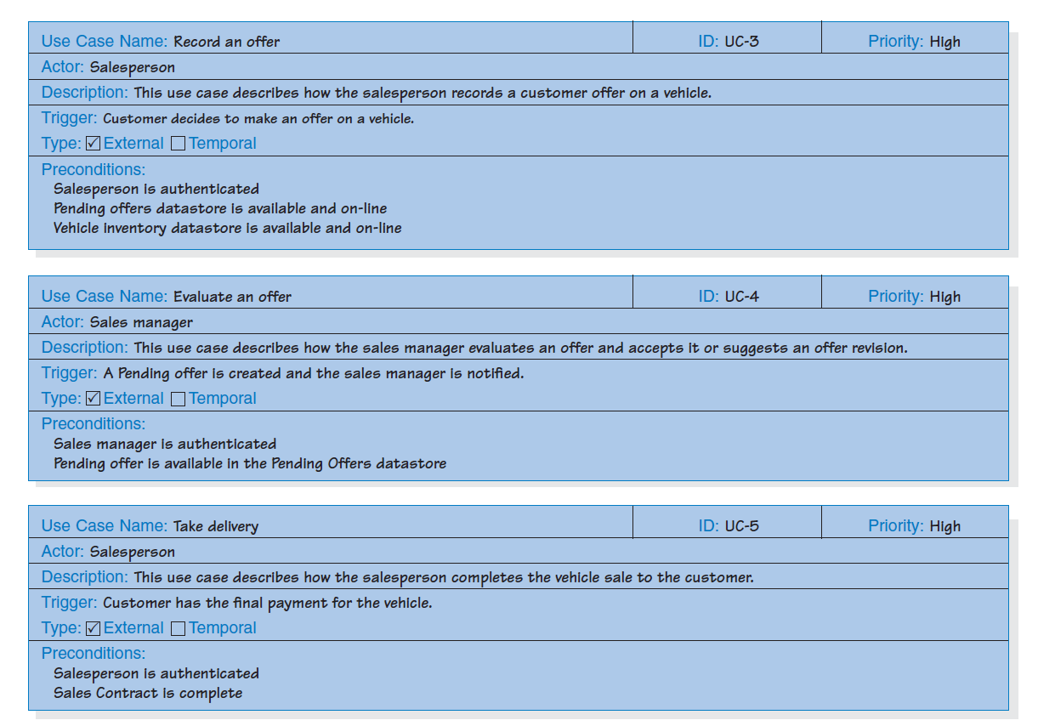
Example-Identifying the Major Use-Cases

Slide 21
Step 2- Identifying the Major Steps
Choose one major use-case to expand
Before beginning a discussion of the steps, the analyst should ask the users what tasks need to be completed before the use case steps can begin. This helps clarify the preconditions that are necessary for the use case.
The users and analysts work together to describe the envisioned interactions between the user and the system in order to complete the response to the event.
Next, the user–system interactions should be outlined as a series of steps in the Normal Course section of the form.
Describe alternate or exceptional flows
Simplify and organize as necessary

Slide 22
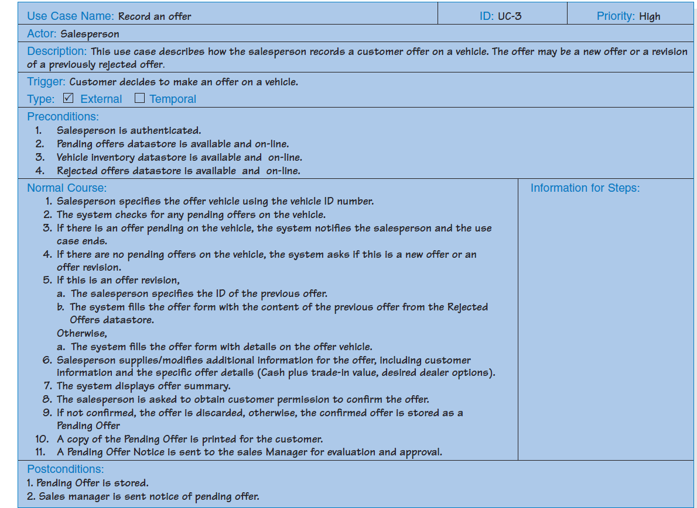
Example- Identifying the Major Steps

Slide 23
Step 3-Identifying the Elements
Identify the major inputs and outputs for each step.
The users and analysts now return to the steps in the use case and begin tracing the flow of the steps. Typically, this means asking what inputs (e.g., information, forms, reports) are used by each step or what outputs it produces.
These are written in the last column on the use case form, with an arrow pointing into or out of a step

Slide 24
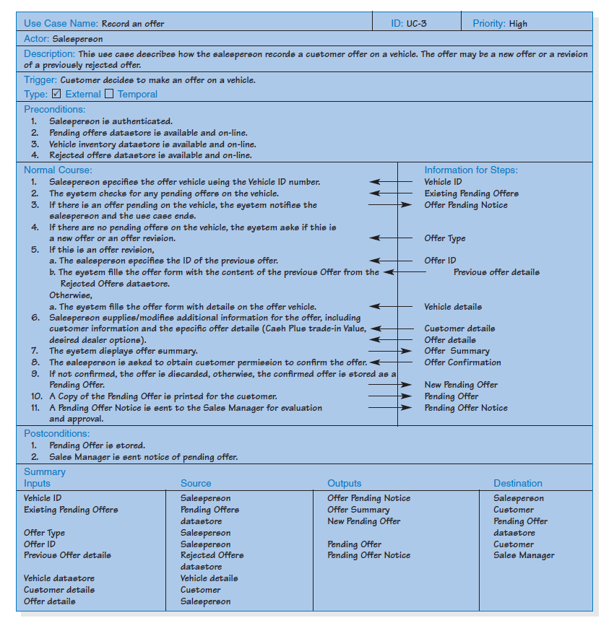
Example-Identifying the Elements

Slide 25
Step 4 - Confirm the Major Use Cases
Review the current set
Consider semantics and syntax
Helpful to involve the users
Iterate the entire set of steps until all use cases are defined

Slide 26
Tune System-Identify Major Use Case
The first step in creating the use cases is to identify the major use cases. The project team felt satisfied that three use cases were sufficient to capture the major task associated with the new system. These use cases were named
search and browse tunes,
purchase tunes,
promote tunes
Tune Shopping System
Search Tune
Purchase Tune
Promote Tune
Tune Shopper

Slide 27
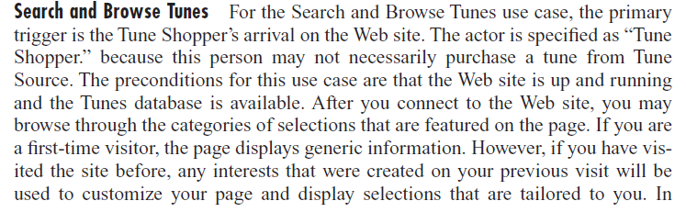
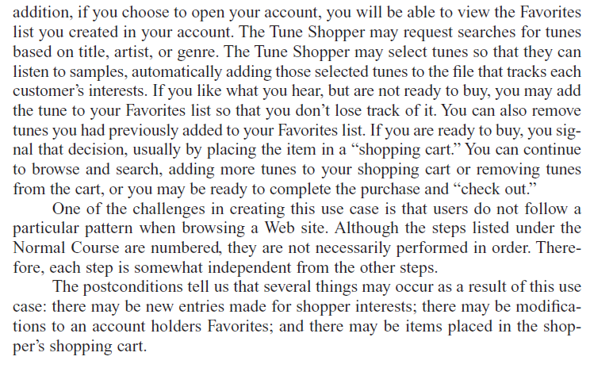
Tune system-Identifying the Major Steps and Elements
Choose one major use-case to expand(Search and Browse)—From elicitation reports

Slide 28
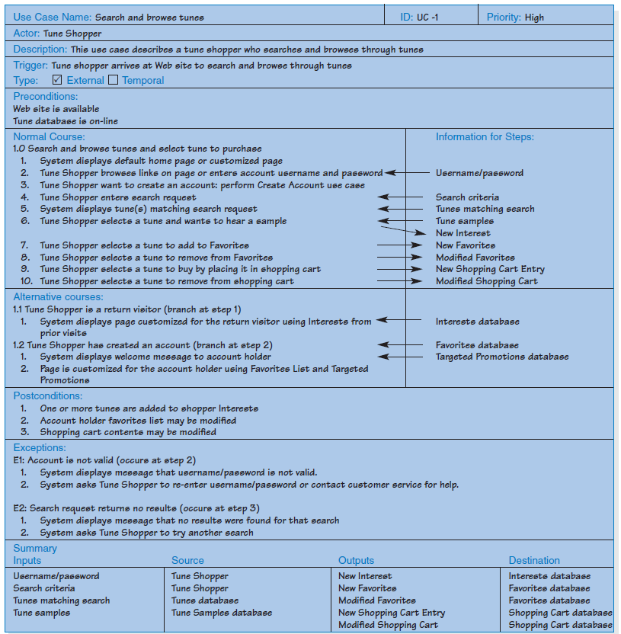
Tune system-Identifying the Major Steps and Elements

Slide 29
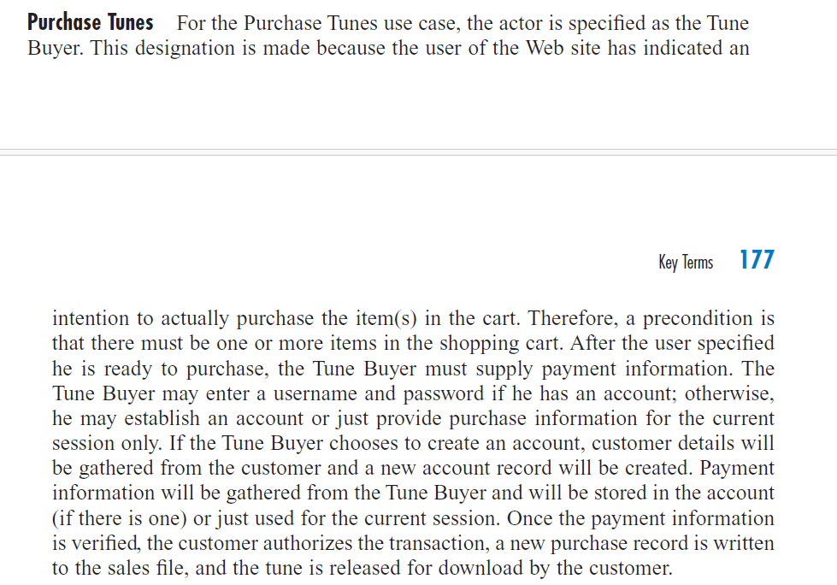
Tune system-Identifying the Major Steps and Elements
Choose one major use-case to expand(Purchase Tune)—From elicitation reports

Slide 30
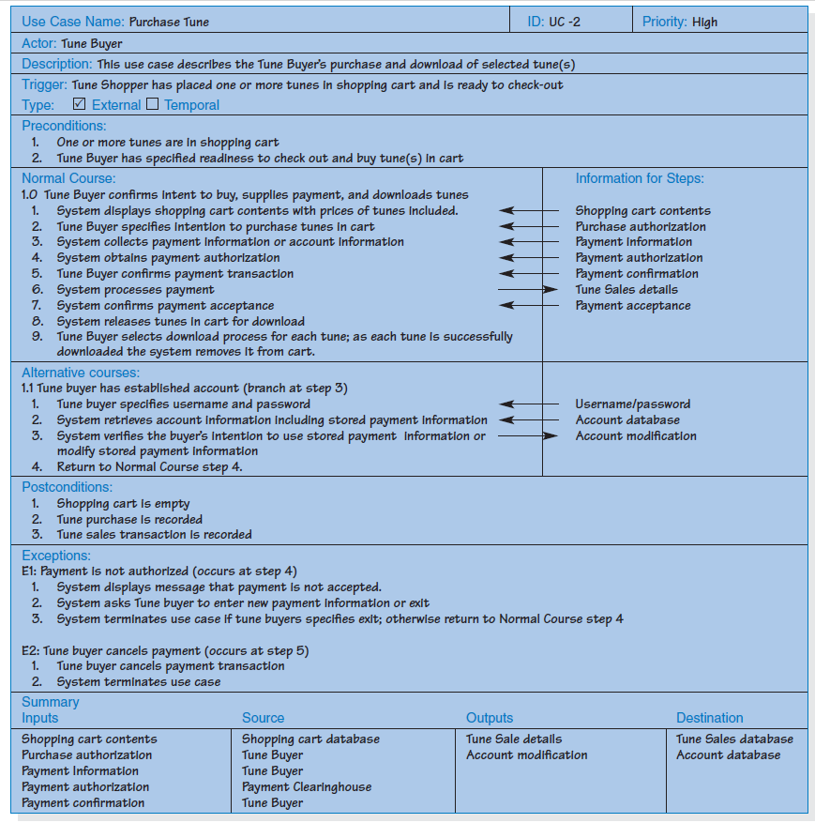
Tune system-Identifying the Major Steps and Elements

Slide 31
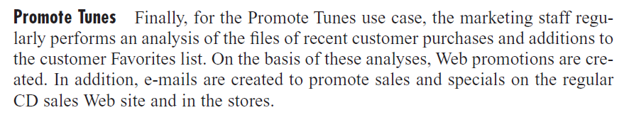
Tune system-Identifying the Major Steps and Elements
Choose one major use-case to expand(Promote Tune)—From elicitation reports

Slide 32
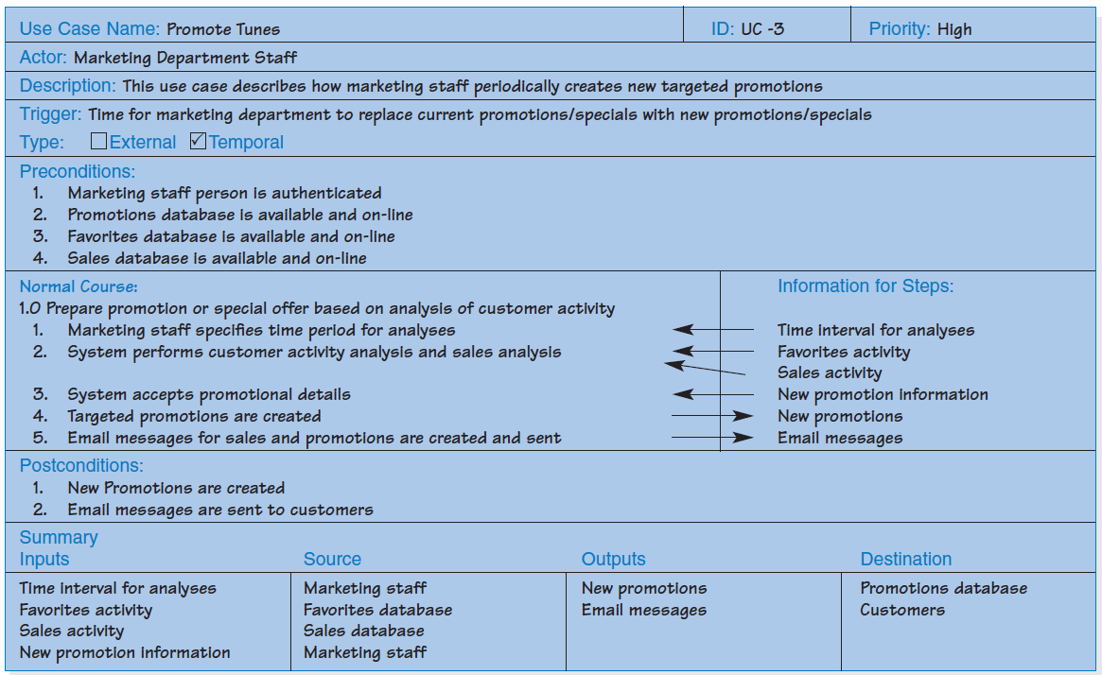
Tune system-Identifying the Major Steps and Elements

Slide 33
Use Cases and Functional Requirements
Use cases are very helpful tools to use to understand user requirements.
The functional requirements in the requirements definition may be modified:
to reflect this more detailed understanding and
to provide insight to the development team on some “back-end” processing that will be needed.

Slide 34
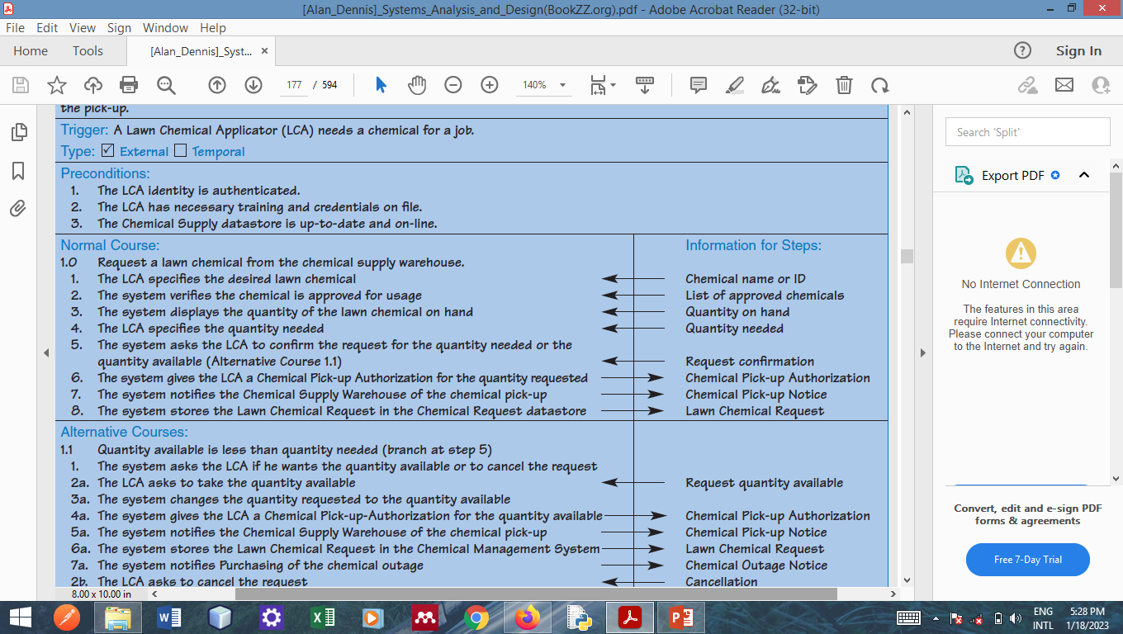
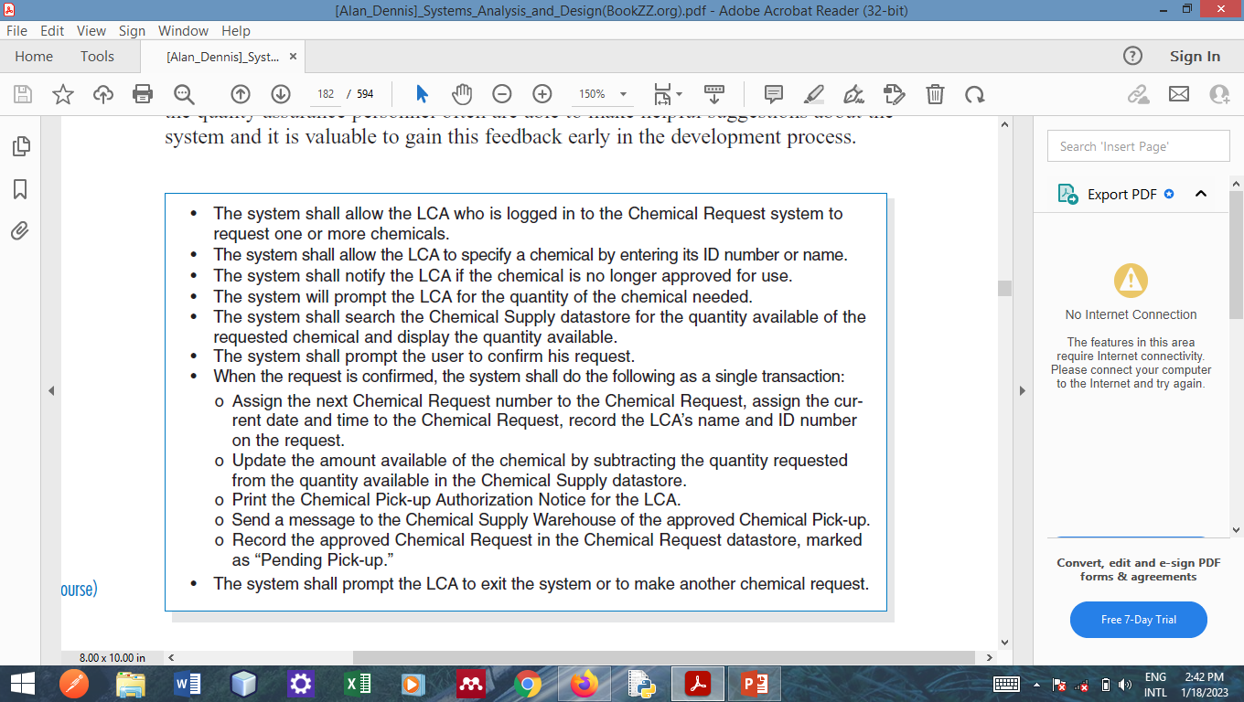
Use Cases and Functional Requirements
Notes:
Functional requirements can easily be based on the Normal Course in the use case.

Slide 35
Summary
A use case contains all the information needed to present a graphical overview of the main functionality of a system expressed in an informal, simple way.
When writing a use case,
develop a list of the major steps,
identify the input(s) and output(s) for every step,
have the users role-play the use case to verify.
Use-case descriptions are the basis for further analysis and design.

Slide 36
Questions !!!

